Slide 1

FMCG Sales Analysis
Project – P175
Group - 05
Mr. Abhishek C Kembhavi
Mr. Shanu Kumar (Mehta)
Mr. Ankush Yadav
Mr. Balakrishna T
Mr. Mohammed Saqlain Ahmed
Miss. Priyanka Wakchaure
Mr. Shubham A Sonawane
This Photo by Unknown Author is licensed under CC BY-SA-NC

Slide 2
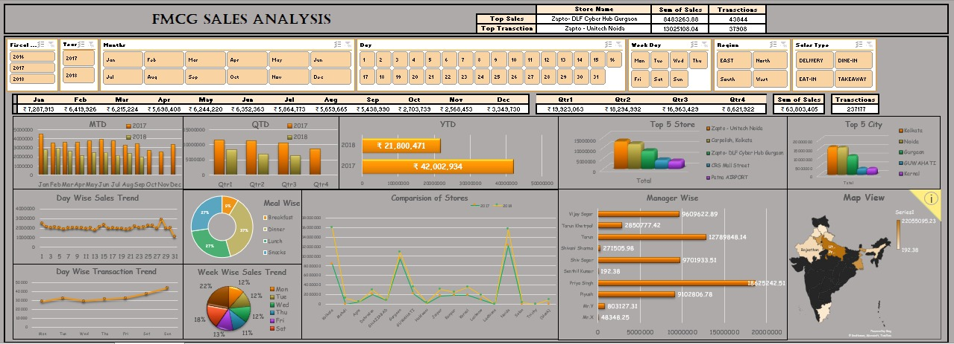
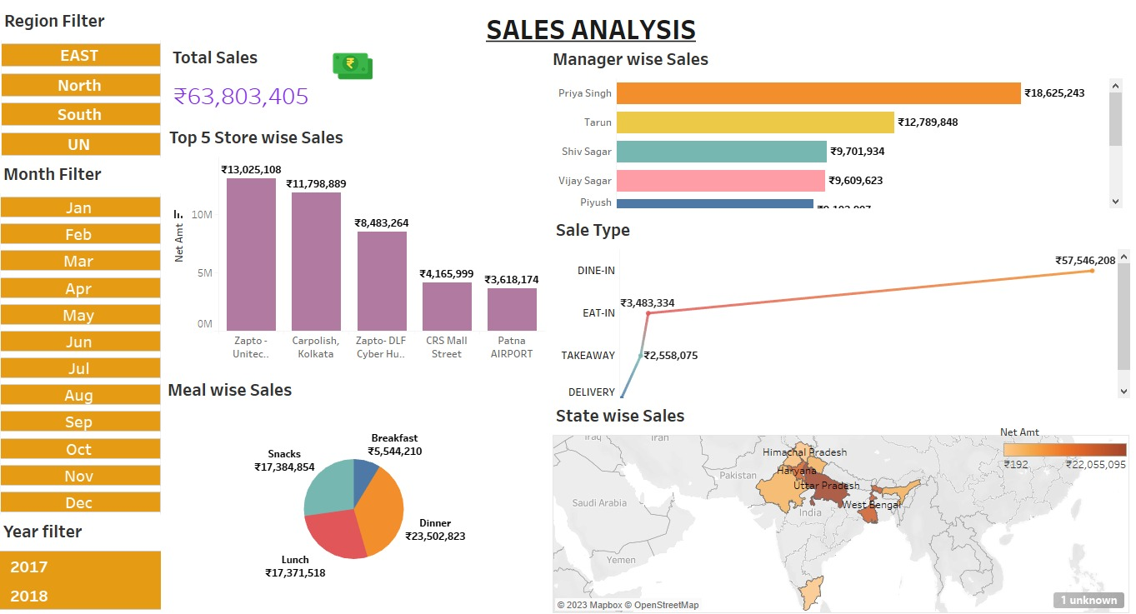
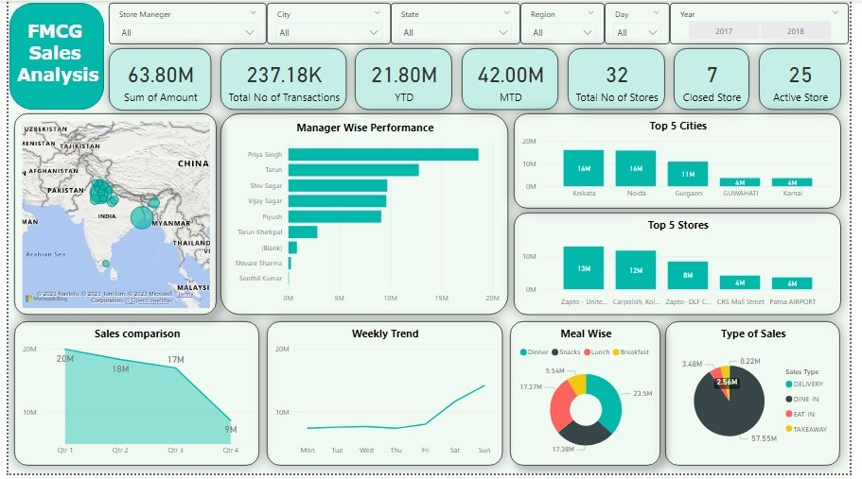
E
X
C
E
L
D
A
S
H
B
O
A
R
D
FMCG Sales Analysis
T
A
B
E
L
A
U
D
A
S
H
B
O
A
R
D
1
FMCG (Fast Moving Consumer Goods) Sales Analysis refers to the process of evaluating and interpreting data related to the sales performance of consumer goods that have a high turnover rate. It involves analyzing sales data, identifying trends, patterns, and insights, and making data-driven decisions to optimize sales strategies. The analysis may include factors such as product performance, market demand, customer behavior, promotional effectiveness, and competitive landscape. The goal is to understand sales performance, identify opportunities for growth, and make informed decisions to drive sales and increase market share in the FMCG sector.
P
O
W
E
R
B
I
D
A
S
H
B
O
A
R
D
2
3

Slide 3




Overview
Total Sales done across India is 63.80 Million Rupees.
Total Number of Transactions are 237K.
Top Store with highest Sales is Zapto Unitech Noida with Rs. 13M.
Top Manager with highest Sales is Priyanka Singh with Rs. 18.6M.
Uttar Pradesh is the state with highest Sales of Rs. 22M.
Dinner is the most preferred meal type by the people as it brings in 36.84% of the sales, followed by both Lunch and Snacks with 27% of sales.
There total of 33 stores across India, out of which 26 are Active and 7 are Inactive.
Dine-in brings in 90% of the sales followed by Eat-in, Takeaway and Delivery which combined together brings in the remaining 10%.
Zapto Trichy Airport store in Tamil Nadu needs improvement as it brings in lowest sales.
Uttar Pradesh and West Bengal states together contribute more than 50% of the total sales.
Sales have been gradually declined from year 2017 to 2018.

Slide 4

Thank you Project Guide: Mahendra

